Slide 1
Modelling migration with other things on supercomputers
Derek Groen, Gebremariam Assres,
Diana Suleimenova

Slide 2
Activities
Lecture: Introduction to supercomputers and parallelized Flee
Lecture: Coupling Flee to other models
Discussion: Ideas for coupled models
Break [15]
Hands-on: Running the parallel and coupled simulations
Lecture: The HiDALGO and VECMA projects
(Optional:) Demonstration of Flee on a supercomputer

Slide 3
Introduction to supercomputers
and parallelized Flee

Slide 4
What is a supercomputer?
A supercomputer is a large machine which has a much higher performance than a regular computer.
Performance is normally measured in FLOP/s, or floating point operations per second.
One FLOP is one basic calculation instruction, e.g.: 5 + 7 = …
A 2-core desktop or laptop can do about 40*10⁹ FLOP/s, or 40 GigaFLOP/s.
Back-of-the-envelope estimate: take the clock speed and multiply it by 8 * the number of cores.
Modern supercomputers do at least 1*10¹² FLOP/s, or 1 PetaFLOP/s.

Slide 5
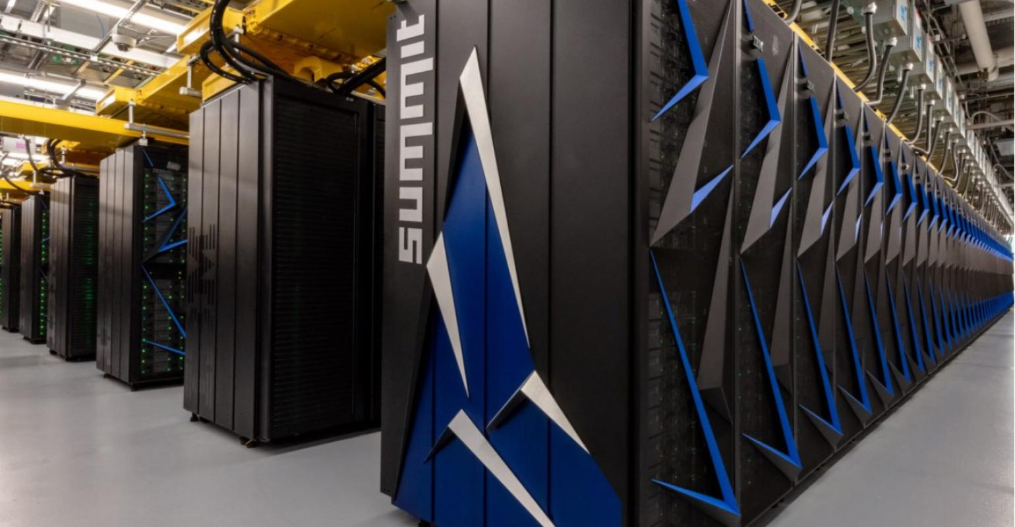
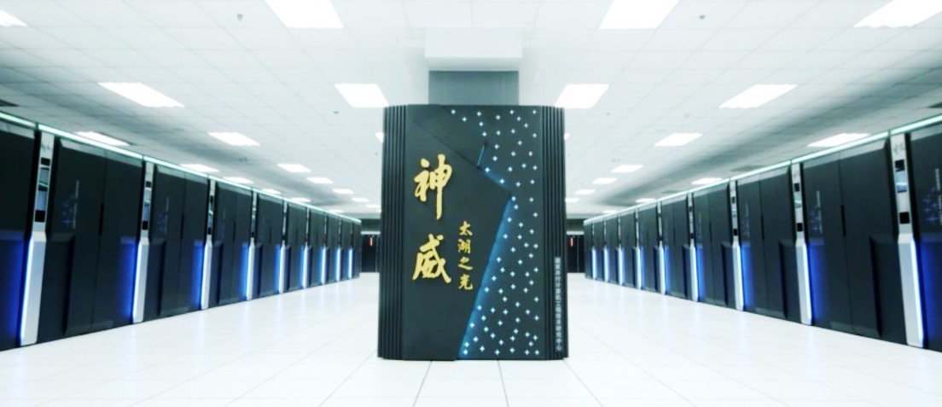
The World’s biggest
Summit, based in Oak Ridge, United States.
#1 in the world at 200 PFLOP/s.
2.4 Million cores.
SunWay TaihuLight, based in Wuxi, China.
#3 in the world at 125 PFLOP/s.
>10 million cores.

Slide 6
Three ways to scale
Parallelizing/refining single scale models.
Constructing multi-scale models.
Adding VVUQ
More cores, faster time to completion, more detailed problems.
More cores, more couplings, more simulated phenomena incorporated.
More cores, more robustness, reproducibility and reliability.

Slide 7
Parallel Computing
Important: supercomputers are not much faster than desktops.
They can just calculate more at the same time.
Compare it to building a house with 100 people, instead of 1.
The key to using supercomputers efficiently is to make sure your code distributes all the work evenly across all its cores.
A good parallel code can be 10, 100, 1,000 or even 1,000,000 times faster than a non-parallel code.

Slide 8

Parallelizing and enhancing Flee
Parallelization
Uses the Message Passing Interface for Python (MPI4Py)
Agents are equally distributed across processes.
Locations are still duplicated across all processes.
Enhancing the single scale model.
Add detail to location graphs.
Specify path type more explicitly.
Enhance refugee destination selection algorithms.
Current arrivals appear OK, but the journey times are unrealistically long…
Bottlenecks: Ruleset development and validation.

Slide 9
Parallel algorithm
if self.total_agents % self.mpi.size == self.mpi.rank:
self.agents.append(Person(location))
Loop:
Update location scores & simulation time.
Evolve all agents on local process.
Aggregate Agent totals across processes (MPI_AllGather).
Complete the travel, for agents that have not done so already.
Aggregate Agent totals across processes (MPI_AllGather).

Slide 10
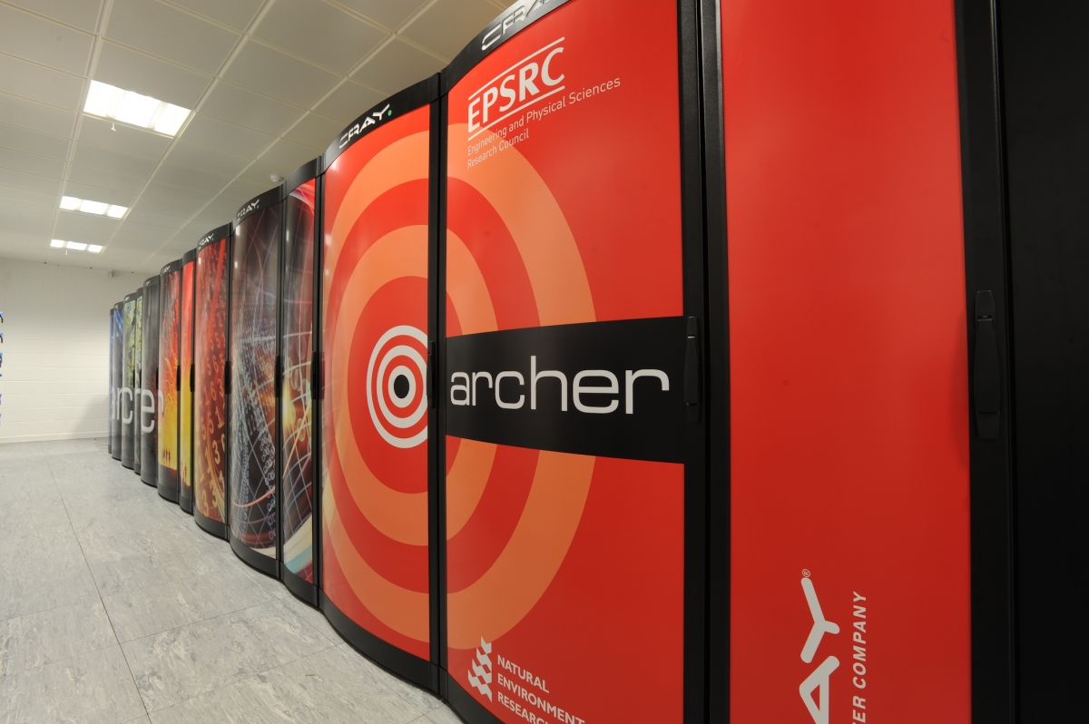
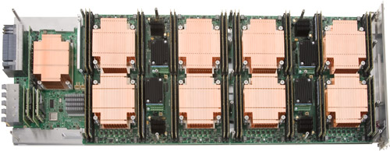
ARCHER supercomputer
Edinburgh Parallel Computing Centre
Edinburgh, United Kingdom
Cray XC30 machine built in 2013.
4,920 nodes
118,080 compute cores
64 / 128 GB of RAM per node.
12 core processors, 2.7 GHz
2.6 PFlop/s = 2.6*10¹⁵ ops / s

Slide 11
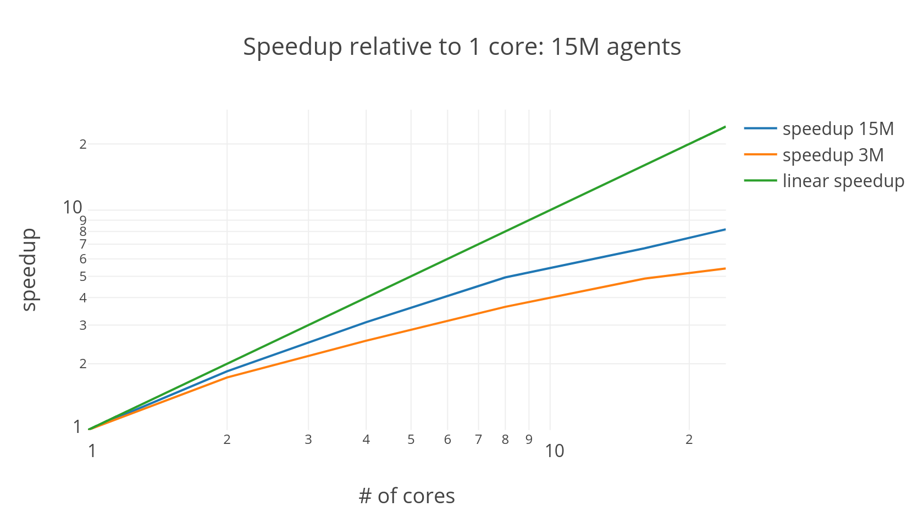

Slide 12
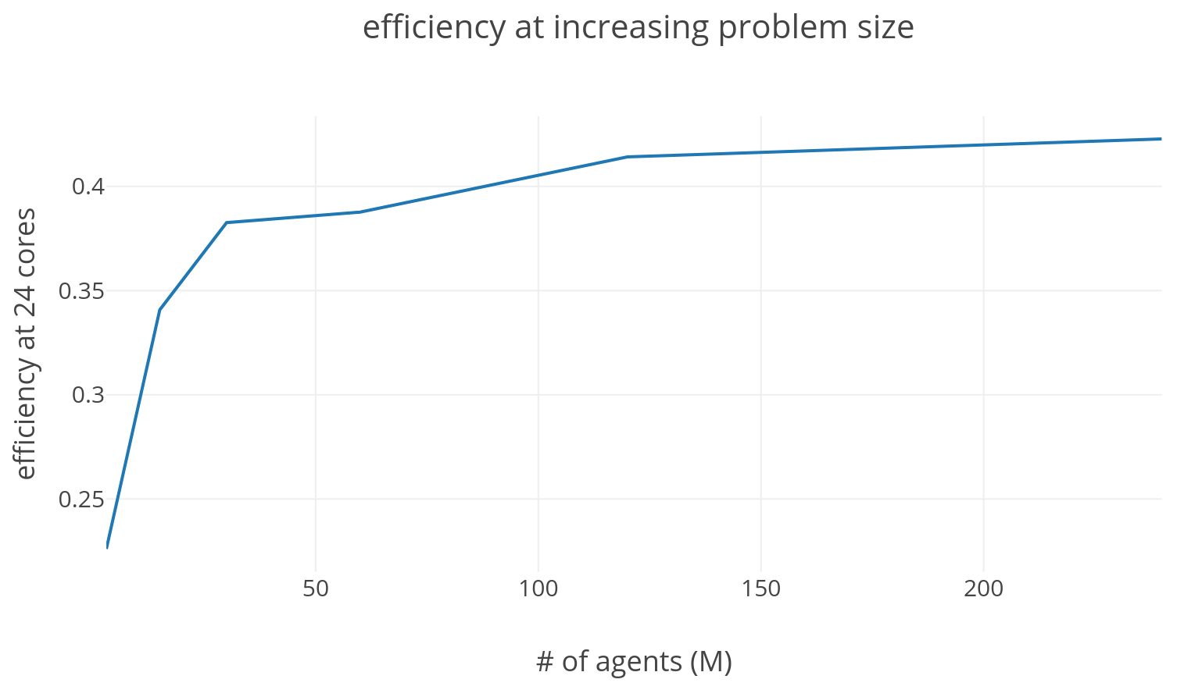

Slide 13
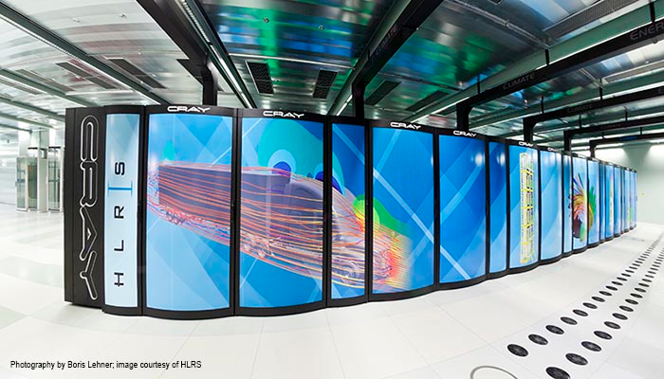
Hazel Hen supercomputer
HochLeistungs Rechenzentrum Stuttgart
Stuttgart, Germany
Cray XC40 machine built in 2015.
7,712 nodes
185,088 compute cores
128 GB of RAM per node.
12 core processors, 2.5 GHz
7.4 PFlop/s

Slide 14
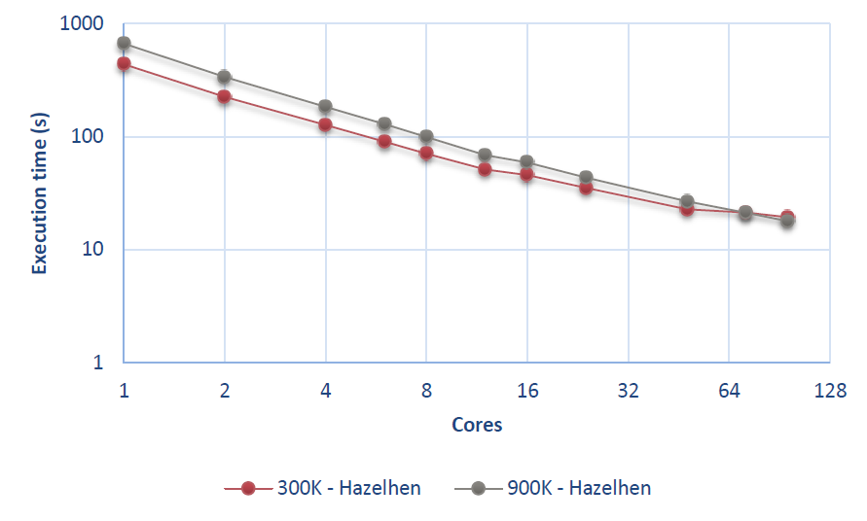

Slide 15
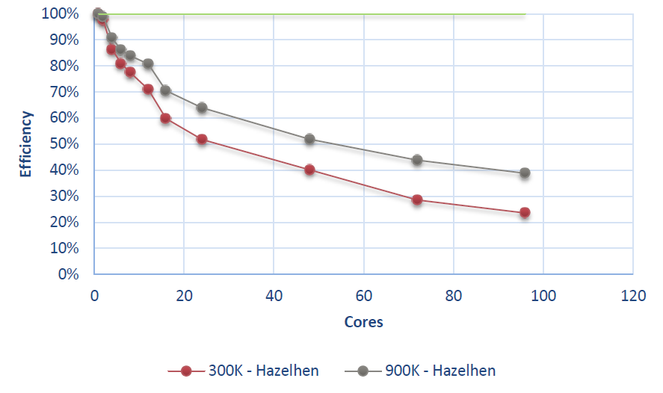

Slide 16
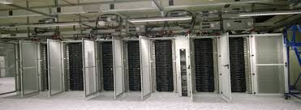
Eagle supercomputer
Poznan Supercomputing & Networking Centre
Poznan, Poland
Huawei machine built in 2015.
1,178 nodes
32,984 compute cores
256 GB of RAM per node.
14 core processors, 2.6 GHz
1.4 PFlop/s

Slide 17
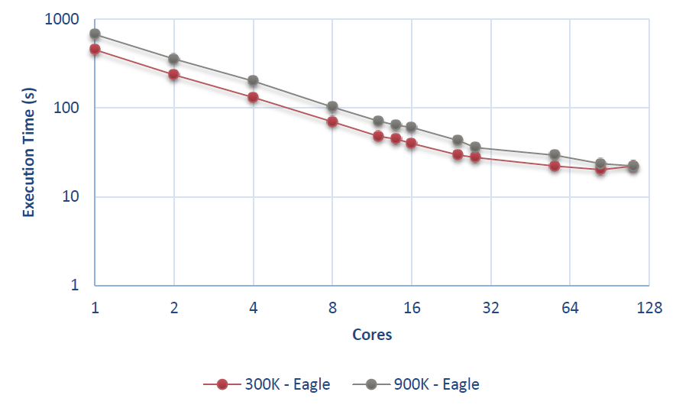

Slide 18
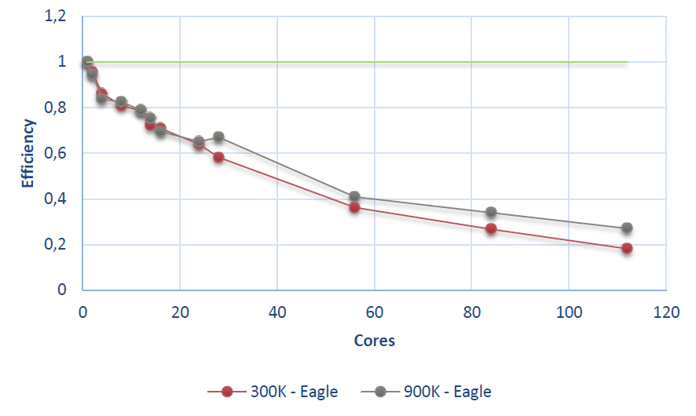

Slide 19
Future work
Our parallel code can be 20 times faster than a non-parallel one, but we want to improve that.
The aim is to have a code that can be a few hundred times faster by the end of the project (December 2021).
How?
Have more detailed location graphs.
Parallelize the updating of locations.
Define more advanced rule sets for the agents.

Slide 20
Coupling Flee to
other models

Slide 21
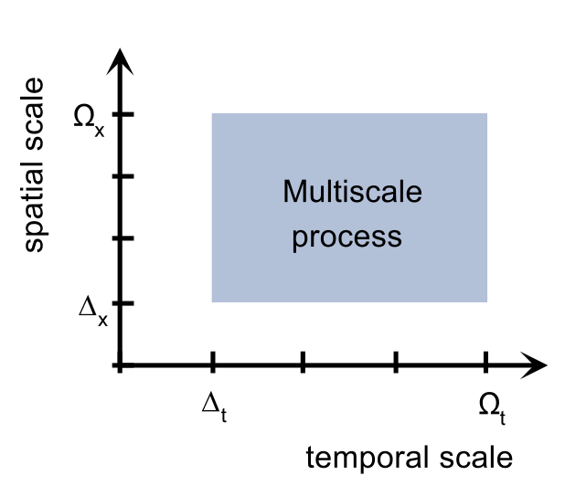
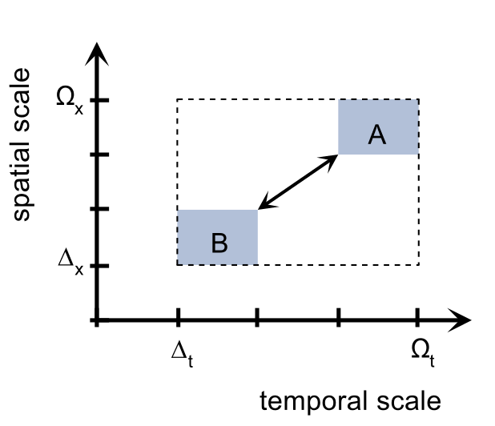
What is model coupling?
The world operates across all scales in time and space.
Models do not.
An N-body simulation may model planets in a galaxy.
A CFD simulation may model blood in a vessel.
A migration simulation may model people within a continent.
To benefit from the predictions of different models, we need to couple them.
If models have different scales, it’s multiscale modelling.
Borgdorff et al., JPDC, vol. 73, no. 4, April 2013, pp. 465-483.

Slide 22


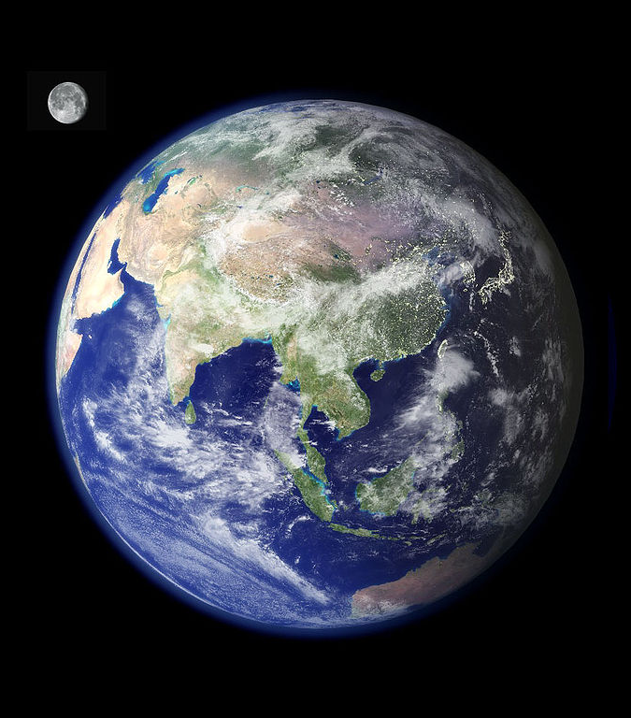
Example questions that will need model coupling
How do cracks propagate in a sheet of material?
Need a macroscale model to resolve the material,
and a molecular (or even quantum-mechanical) model to figure out how individual bonds in molecules break.
How do stars evolve in a galaxy?
Need an N-body model to calculate the movement of the stars,
and a stellar evolution model to calculate how each star changes as it ages,
and a stellar collision model to calculate what happens when stars collide.
How does pollution affect a city?
Need e.g., a traffic model to predict where pollution is generated,
and a weather model to predict how the pollution changes over time, e.g. due to wind or rain.

Slide 23
How can you couple models?
Write two models in one code. (monolithic) | Quick solution, but your code becomes more complicated, and it will become harder to add more models, or to swap them.
Two separate model codes, interact by reading/writing files. (file coupling) | Easy to implement, but may become slow if information is exchanged frequently.
Two separate model codes, interact using network communication. (network coupling) | Very high performance, but harder to implement and codes may need to run at the same time.
Two separate model codes, interact using a repository or database. (repository coupling) | Not fast, but easy to implement and great for curating intermediate results.
Groen, D., Knap, J., Neumann, P., Suleimenova, D., Veen, L. and Leiter, K., 2019. Mastering the scales: a survey on the benefits of multiscale computing software. Philosophical Transactions of the Royal Society A, 377(2142), p.20180147.

Slide 24
How can you couple models?
Write two models in one code. (monolithic) | We don’t recommend this.
Two separate model codes, interact by reading/writing files. (file coupling) | We’ll do this today.
Two separate model codes, interact using network communication. (network coupling) | We have experience doing this, and can point you to the right tools.
Two separate model codes, interact using a repository or database. (repository coupling) | We have experience doing this, and can point you to the right tools.

Slide 25
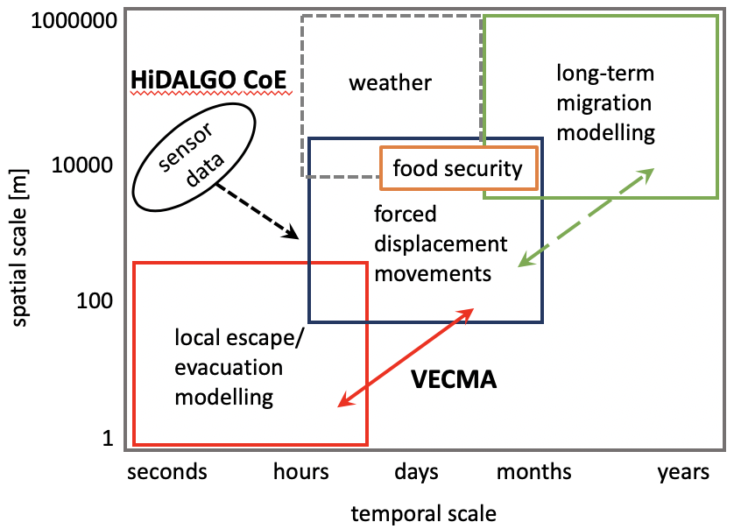
Overview of different multi-scale / coupled models
Prototyped:
Local escape.
Food security.
Conflict evolution.
Proposed:
Long-term migration
Weather
Telecommunications
Other sensor data
Satellites?

Slide 26
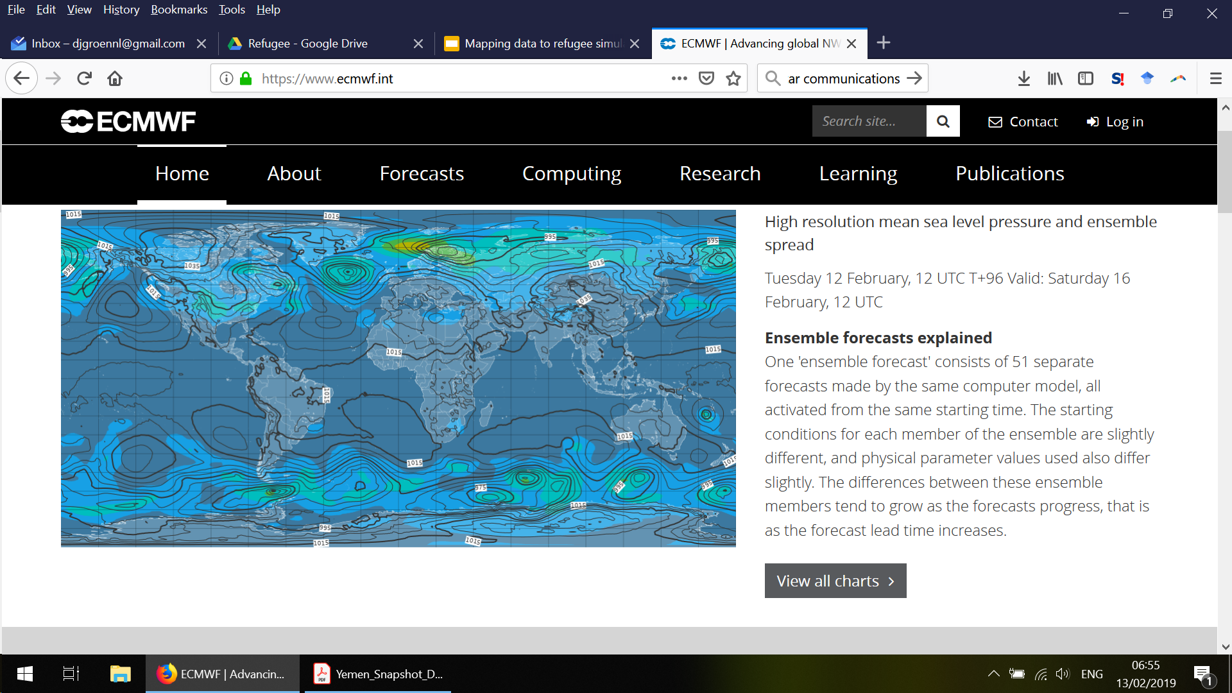
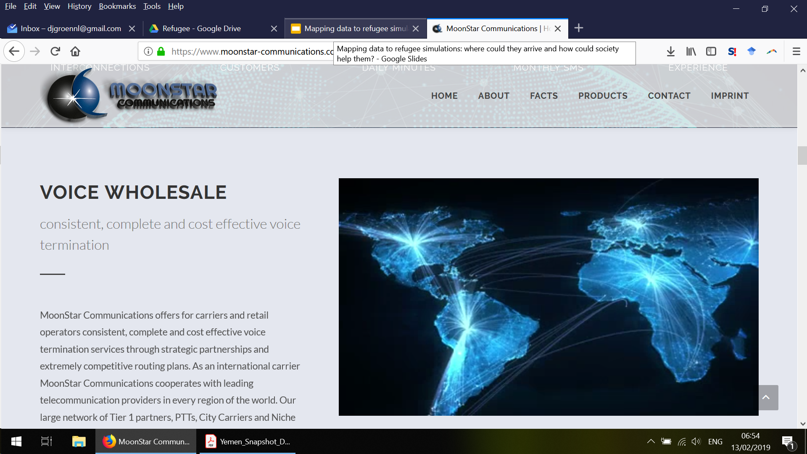
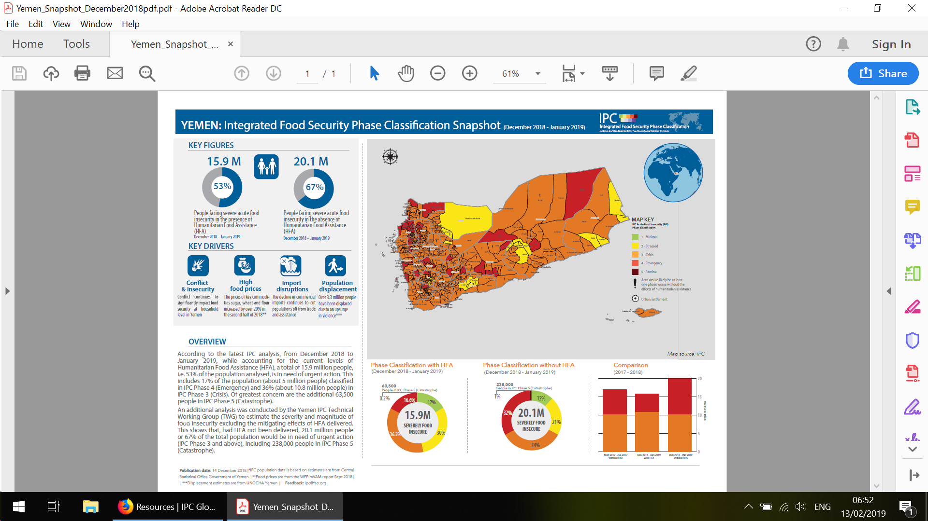
Data sources
Weather data (ECMWF)
http://www.ecmwf.int
International calling data
https://www.moonstar-communications.com/
Food security data
http://www.ipcinfo.org
…. But there probably is much more!

Slide 27
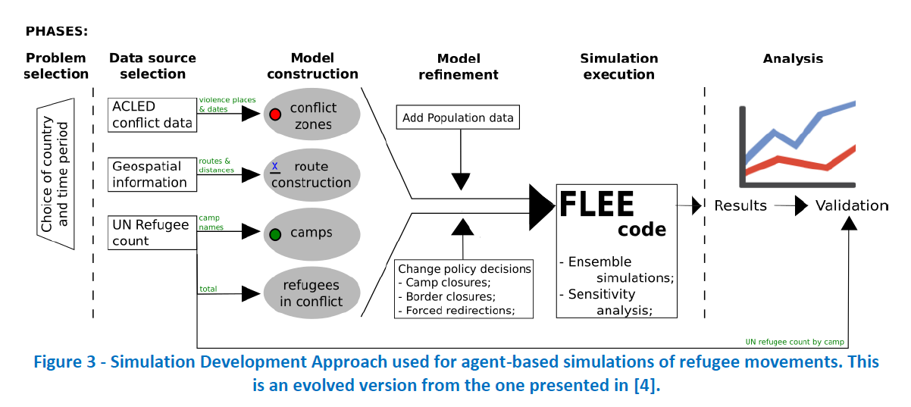
Example: Flee + conflict evolution

Slide 28
Example: Flee + conflict evolution
What about future conflicts?

Slide 29
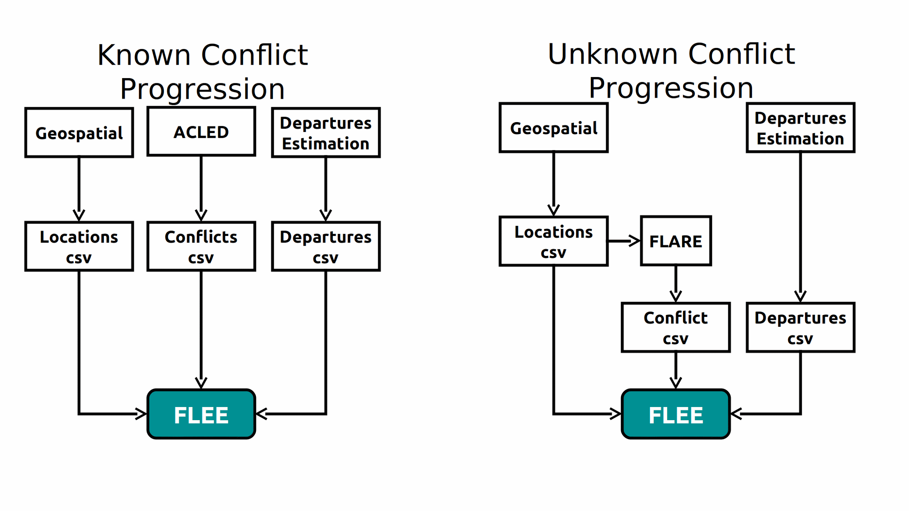

Slide 30
About Flare
Aim: make a prediction how a conflict could gradually evolve, so that we can investigate how different conflict scenarios may affect arrivals of displaced people.
Model under development.
The code is there, but we are still looking for appropriate algorithms.
The model is stochastic, so every run gives a different outcome.
Open-source (BSD 3-clause license).
Written in Python 3.
Available at: http://www.github.com/djgroen/flare-release

Slide 31
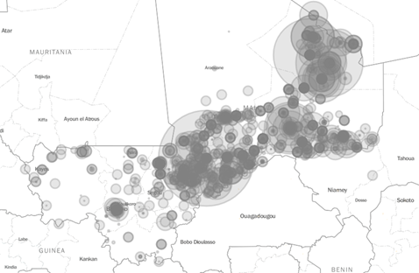
Example of different Flare executions (Day 1)
Since the algorithm is stochastic, it can lead to different outcomes every time the simulation is run.
Kidal
Mbera

Slide 32
Example of different Flare simulations (Day 30)
Since the algorithm is stochastic, it can lead to different outcomes every time the simulation is run.

Slide 33
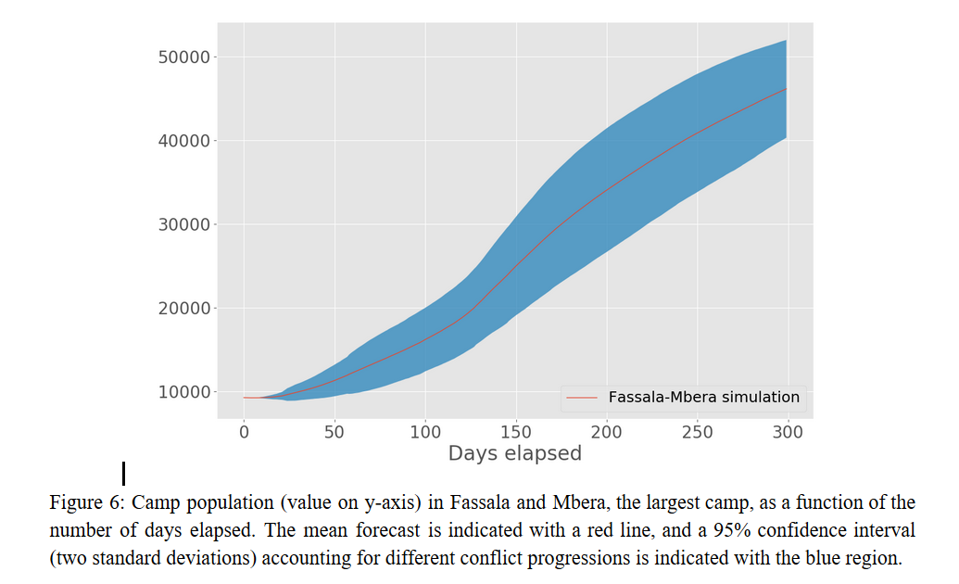

Different conflict evolutions can be fed into Flee
...leading to different arrivals in each of the camps:

Slide 34
Discussion: what kind of coupled model would you like to make?

Slide 35
Running the parallel and coupled simulations

Slide 36
How to couple to Flee?
Existing approaches:
As input CSV file.
As input CSV file, but provided dynamically at each time step (e.g., through automated transfers).
Also easily possible:
Via TCP (e.g., using MPWide).
Using a database or repository system.
(MUSCLE is not an option, as the weather simulation is run externally)
Notes:
TCP = Transmission Control Protocol
MPWide = A communication library for message passing across wide area networks.

Slide 37
What to couple to Flee (metrics)
Time resolution:
Daily for macro model.
Per 10 minutes for micro model (if we will use it).
Space resolution:
10x10 km could work, as we use a 10km threshold to distinguish cities, and even walking refugees tend to travel at least 30 km per day.
Micro models may need only one “pixel”…
Metrics
Precipitation - for initial hypothesis
Temperature - important especially for indirect influencers.
Uncertainty / sensitivity
How do we capture the likely possibilities in the first week, the first month and the first year?

Slide 41
The HiDALGO and
VECMA projects

Slide 42
Two exascale computing projects
http://www.hidalgo-project.eu
Horizon 2020 Centre of Excellence (€8M)
Started Dec 2018.
Aim: create coupled simulations for large supercomputers
Refugee simulations is one of 3 applications.
http://www.vecma.eu
Horizon 2020 project (€4M)
Started June 2018.
Aim: establish a toolkit to validate, verify and quantify uncertainty.
Refugee simulation is one of 5 application domains.

Slide 43
HPC and Big Data Technologies for Global Systems
Seeks to establish a HPC modelling and data research framework to address global challenges
3 pilot applications with components can be re-used for other purposes
Established to link up different communities, with a focus on tackling global challenges using HPC and HPDA
Has unique modelling and analytics expertise, and is dedicated to share this to the benefit of the wider community in the EU and outside of it
A 3-year project, and therefore a suitable launchpad for sustained and longer-term research initiatives

Slide 44
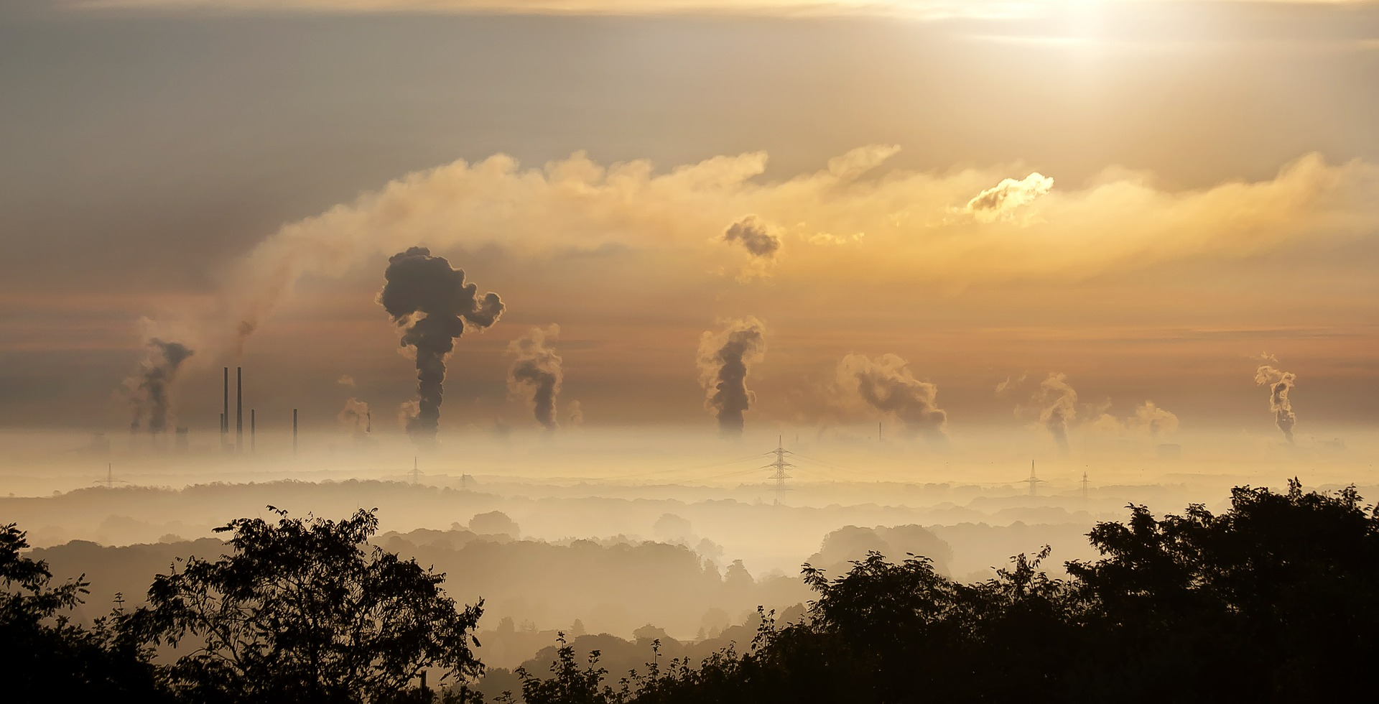
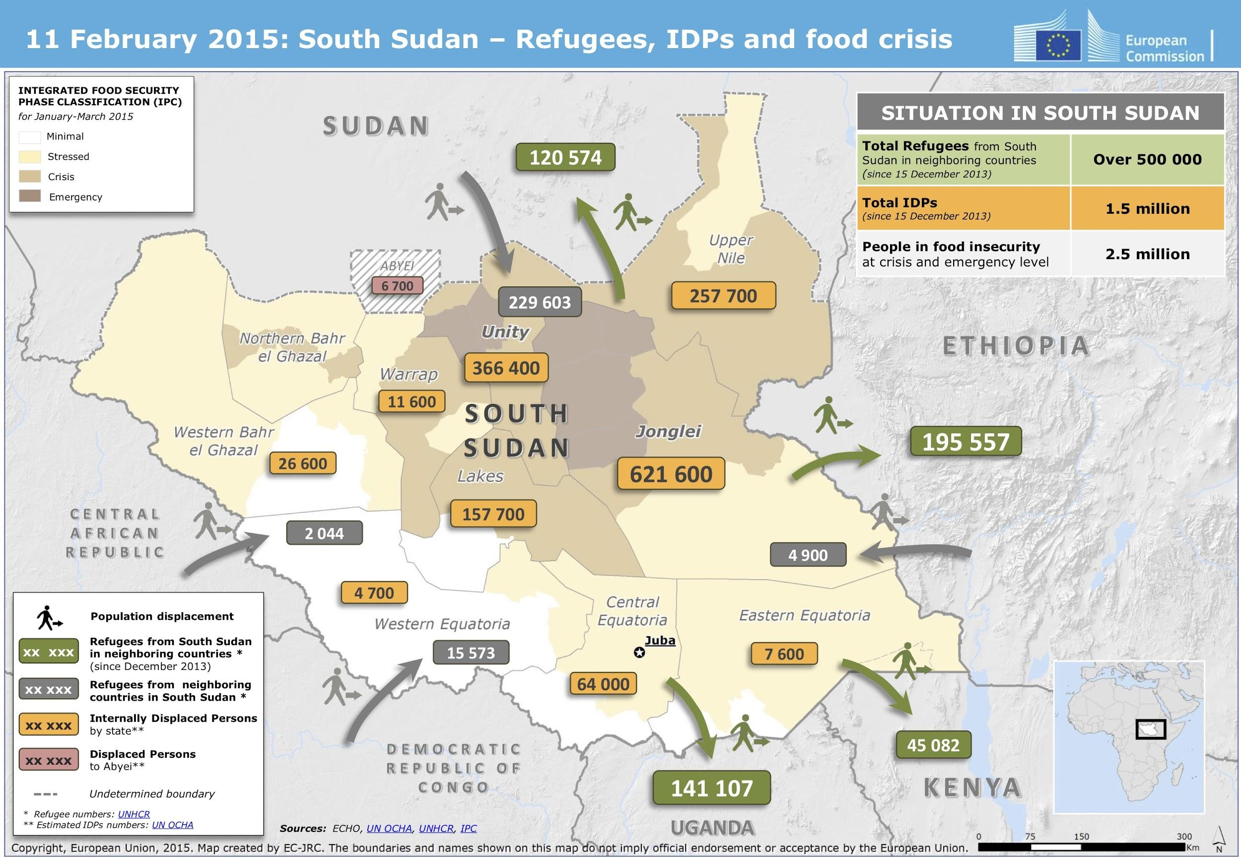
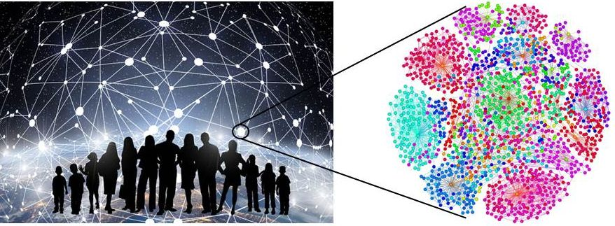
Pilot Applications
Migration Modelling
Urban pollution
Social networks

Slide 45
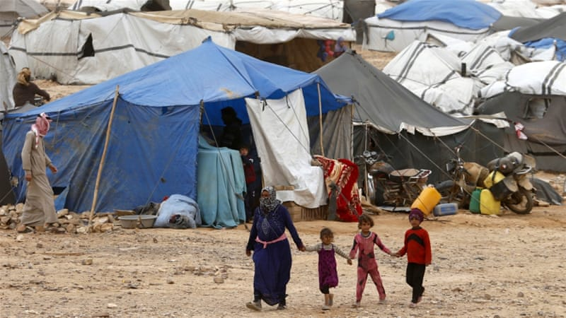
Migration Modelling
Where will refugees arrive?
Where should we provide aid?
How can we improve their journeys?
How could policy decisions affect them, as well as other stakeholders?
What makes refugees depart?
And more broadly, what about the interplay of (forced) migration with supply chains and economic aspects?

Slide 46
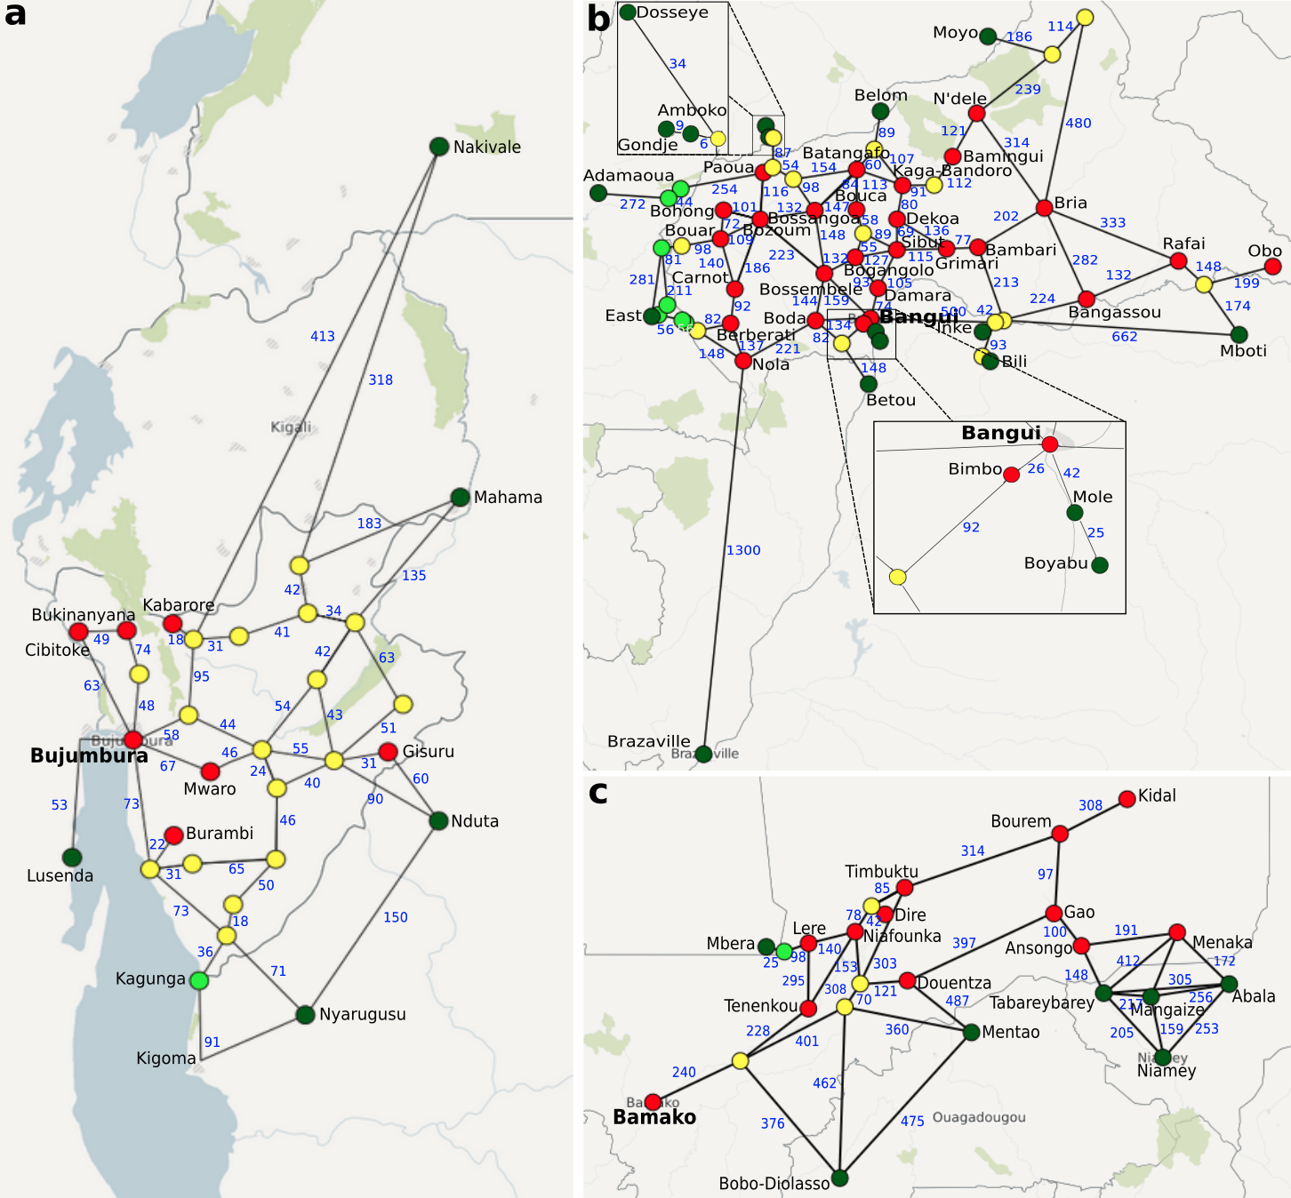
What HiDALGO brings?
Refugee movements
Weather
Telecommunications
Conflict propagation
Food security
Localized escape

Slide 47
Boosting data research capacity
As a Centre of Excellence, our main aim is enable more and better research using the infrastructure available in the EU. We seek to
Bring new global challenge applications to the EU HPC landscape:
Establish model building capacities through collaboration, prototyping, validation, dissemination.
Use existing infrastructure to tackle new research questions.
Boost existing data analytics and modelling approaches:
Improve performance, scalability, accuracy and resolution.
Powered through 2 supercomputing centres, as well as several data analytics partners
Introduce data and modelling research in global challenge communities:
Raise awareness about the importance and potential among governments, NGOs, and society at large.

Slide 48
Key Challenges
Collecting good quality Big Data is a key requirement.
Can we keep the data ethical (e.g., no possibly leakage of private/personal data)?
Can we collect data systematically?
Can we prevent bias from corrupting our data sets?
We need a strategy to forecast and propose models in “data-dry” environments.
Traditional machine learning and big data techniques will not thrive here, simulations can.
Broader research questions (economic, supply chain aspects) require integrations with new models.
Who can bring the data to validate these models against?
And eventually: can we use big, expensive forecasting technologies to establish heuristics for smaller, cheaper ones?

Slide 49

Verified Exascale Computing for Multiscale Applications
Horizon 2020 EU project (FET-HPC)
http://www.vecma.eu
Aim:
Establish a toolkit for verification, validation and uncertainty quantification for multiscale applications that require large scale supercomputers.
Duration: June 2018 - June 2021.

Slide 50
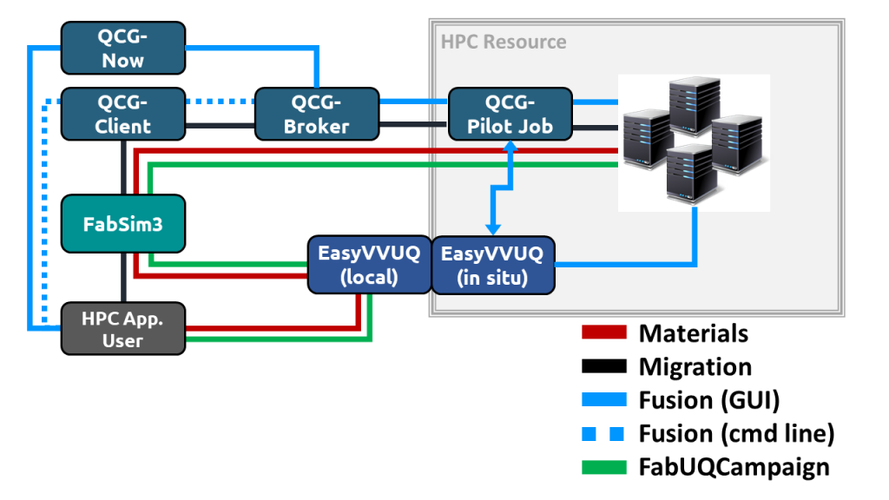
VECMAtk Tube Map
Support the creation of procedures for uncertainty quantification and sensitivity analysis.
Enable UQP-based application execution using a variety of infrastructures.
Facilitate curation and automation of complex applications.
Provide the ability to flexible schedule large numbers of jobs on remote resources.
Be used.

Slide 51
FabSim3 plugins
FabFlee
Automates refugee simulations. In use for research purposes.
FabMD
Ensembles and UQ for materials.
FabDummy
Example plugin to help reduce learning curve.
http://www.github.com/djgroen/FabDummy
FabUQCampaign
Plugin for performing UQ using stochastic collocation.
http://www.github.com/wedeling/FabSC
FabMUSCLE, FabAlya
Planned.

Slide 52

VECMAtk Applications
Migration → conflict evolution + forced migration with SA & UQ.
Fusion → coupled simplified models with on-site EasyVVUQ & Pilot Jobs.
Materials → ensemble LAMMPS workflow with UQ.
FabUQCampaign → ensemble workflow with UQ (stochastic collocation).
http://www.vecma-toolkit.eu

Slide 53
Our task
Do validation and uncertainty quantification for refugee movement simulations.
Automate these procedures to make them easier to run and modify.
Develop generic tools so this can be done with other large applications.

Slide 54

Linking innovation hubs
We already combine expertise from 13 different partners across Europe on High Performance Computing, Data Analytics and Artificial Intelligence.
But we also spark innovation beyond that, for instance through:
Linked EU initiatives (e.g., VECMA project on uncertainty and validation).
Spin-off innovation and impact efforts.
MOE/BMBF collaboration between HiDALGO and researchers in the Ukraine.
Brunel Impact Accelerator to forge new collaborations with Central and Eastern Africa.
Emerging collaborations with MSF, UNHCR and SAROBMED.
Voluntary data research collaborations.
(Summer) student projects

Slide 55
Demonstration of Flee on
a supercomputer

